Slide 1
Battle of Neighborhoods Latin American Restaurants
Autor: Teresa Andia V.

Slide 2

Introduction
1.1 Description of the Problem
New York is known as a state of diverse population. That explains that there are a lot of restaurants with food from different parts of the world. The problem starts with finding a suitable neighborhood place to open a Latin food restaurant.

Slide 3
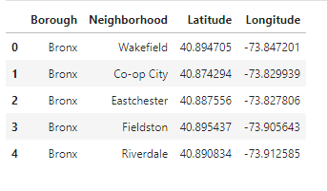
Description of data
New York Data
The database used is a public one that shows each New York’s Borough and neighborhoods with location data.
Foursquare data
With New York data prepared, it is posible to get venues data from each neighborhood with Foursquare API. It is necesary to get a Client ID and password, also it is necesary to define the limit and radius.

Slide 4
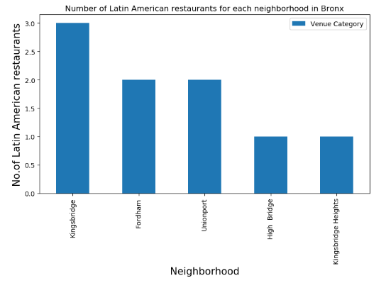
Methodology
With both data obtained. First, let’s find out which neighborhood has the most latin american restaurants at Bronx district.

Slide 5
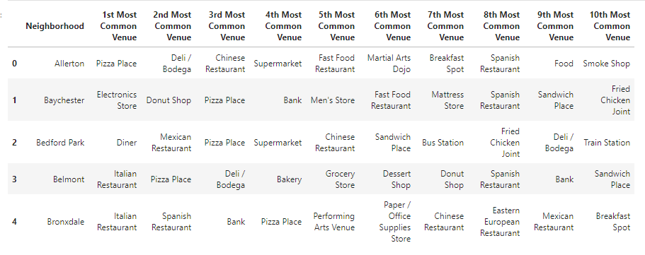
Find out the most common venues on each neighborhoods at Bronx district.

Slide 6
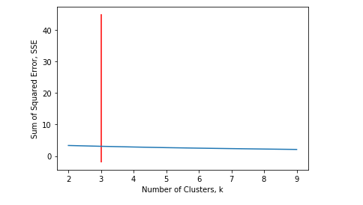
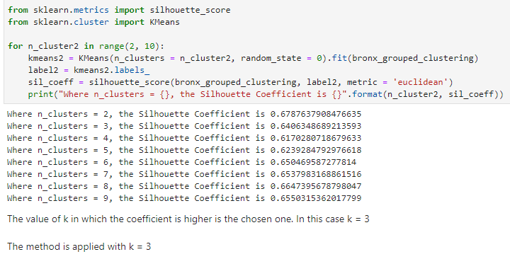
Data Clustering
K – Mean method
Finding out the best ‘k’ value to apply this method.
Elbow Method Silhouette Coefficient
The best value of k is 3

Slide 7
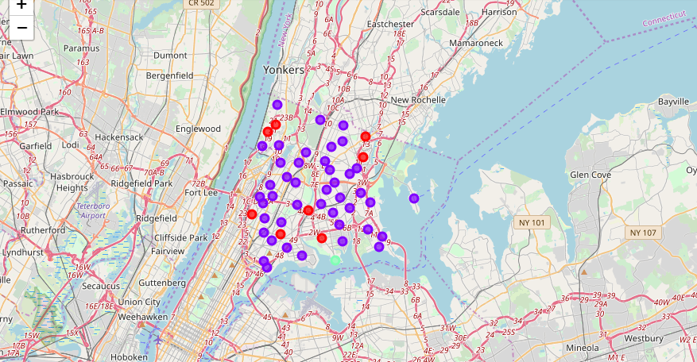
Data Clustering
The result of k-mean method aplication in this case, gives 3 clusters. Those are shown on the next map.

Slide 8
Results
In resume, according to results shown before:
At Bronx district Pizza Place is the most common venue.
The neighborhood with the most Latin food restaurants is Kingsbridge. This neighborhood also seems to be a restaurants district and an appropriate place to open a Latin food restaurant.
Cluster 2 shows that on those neighborhoods there is predominance of restaurants and food places.

Slide 9
Discussion and Conclusion
It is very important to note that Clusters 2 is the most viable clusters to create a Latin American Restaurant. Their proximity to other amenities and accessibility to station are paramount.
In conclusion, this project would have had better results if there were more data in terms of traffic access and the quantity of latin people living on those neighborhoods.

